Slide 1
Blackout Poetry

Slide 2
What is blackout poetry?
Blackout poetry is creative destruction.
Blackout poetry focuses on rearranging words to create a different meaning.
The author uses a permanent marker to cross out or eliminate whatever words or images he sees as unnecessary or irrelevant to the effect he's seeking to create.
The central idea is to devise a completely new text from previously published words and images, which the reader is free to interpret as he wishes.

Slide 3
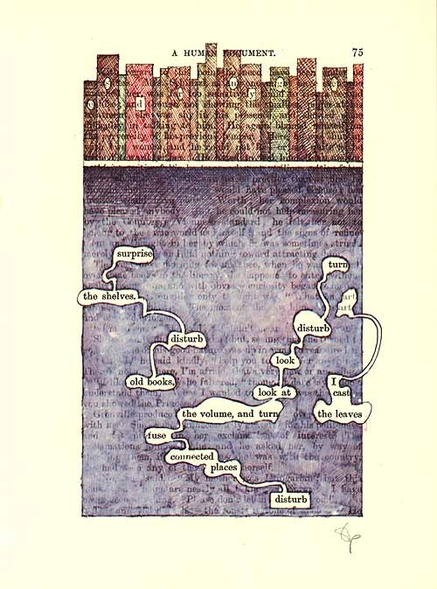
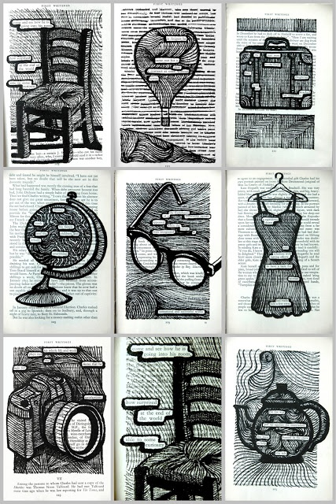

Slide 4
