Slide 1
(Your Interesting Title Here)
By (Your Name Here)
Yes, you can put a picture on this slide ☺
Begin Story

Slide 2
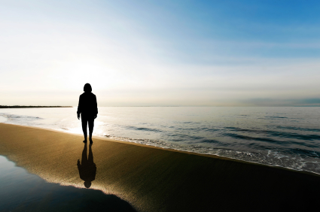
One day while I was walking down the beach I saw a boy swimming in the ocean.
Next Page

Slide 3
Unbeknownst to the boy there was also a shark swimming near him. I was overcome with fear but knew I had to do something. Should I jump in and try to rescue him or should I yell, “Shark, get out of the water!”?
Jump in
Yell, “Shark...”

Slide 4
