Slide 1
Haiku
5-7-5

Slide 2
A Haiku is a traditional Japanese poetic form that is most commonly about nature and seasons.

Slide 3
A Haiku consists of 3 lines. Line 1 has 5 syllables, line 2 has 7 syllables, and line 3 has 5 syllables. A Haiku does not need to rhyme.
White, sandy beaches
Ocean waves from far away
Warm sun shining down

Slide 4
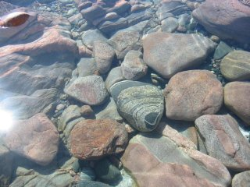
While the smoothest stones
Try to skip and hop across,
The pond claims them all

Slide 5
Flowers withering
Beneath the weight of the sun
Yet the weeds stand proud

Slide 6
Now you try!
5-7-5

