Slide 1
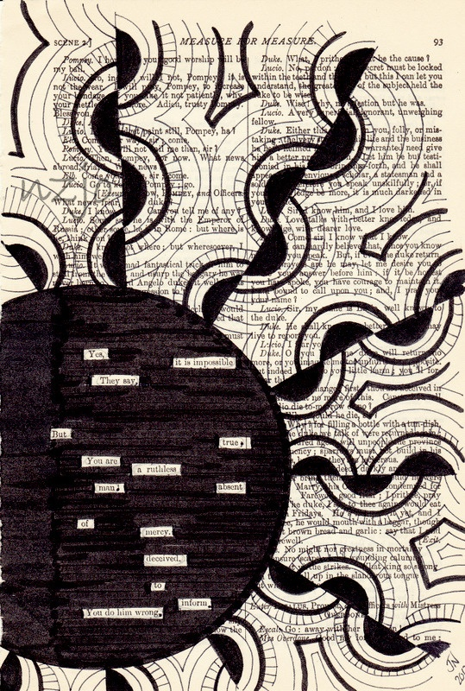
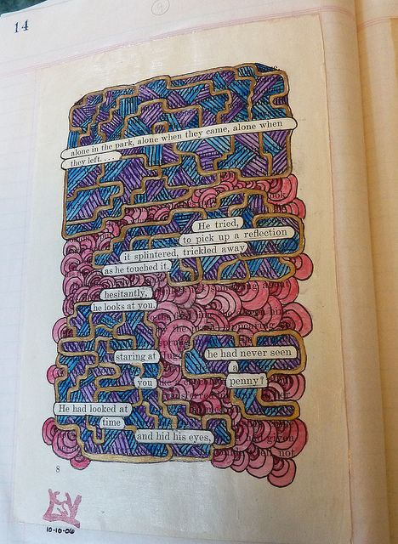
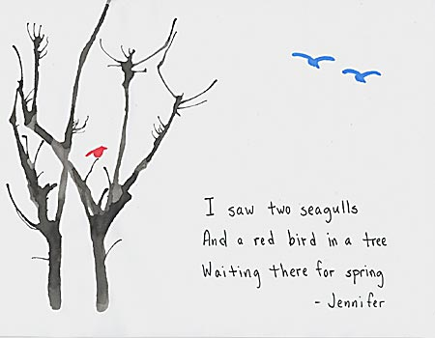
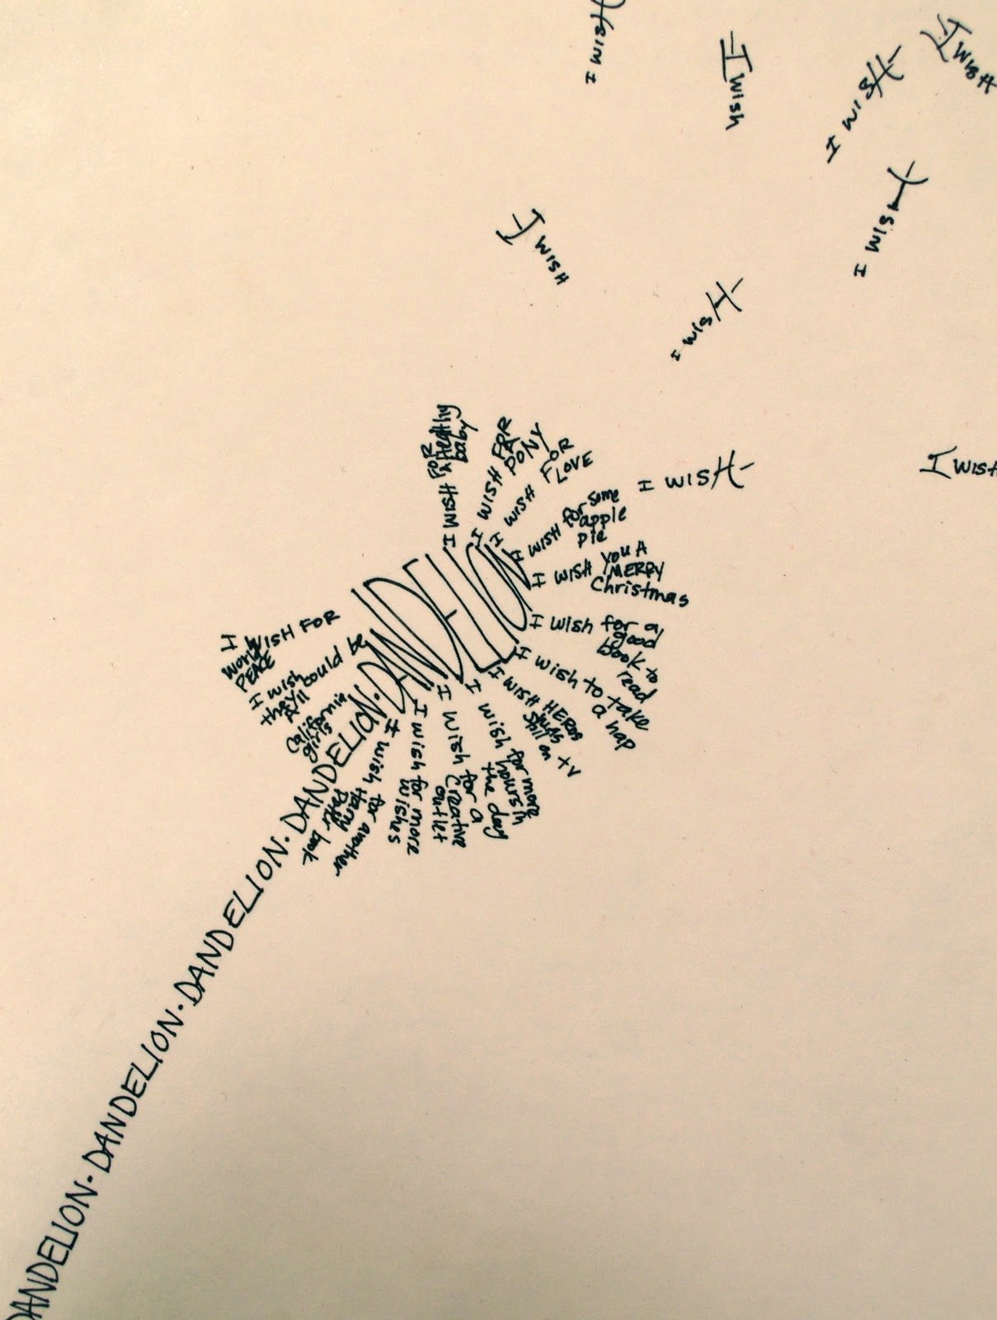
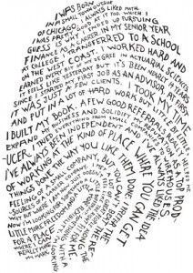
Poetry Elective

Slide 2
What Is Poetry?
It can rhyme, but does not have to.
It can be long or short, and different structures/shapes.
It creates images in your mind—the five senses.
It has rhythm, deep feelings, imagination.
It can be about ANYTHING!
Poetry has moods. It can be funny, sad, scary, etc..
Poetry can teach a lesson about life.
Poetry has few rules!

Slide 3
We will explore the following poetry types:
Haiku

Slide 4
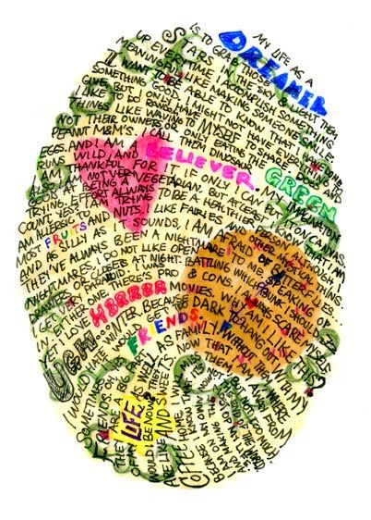
Fingerprint Poetry

Slide 5
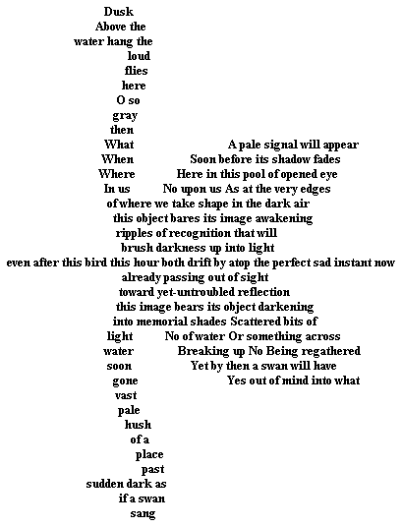
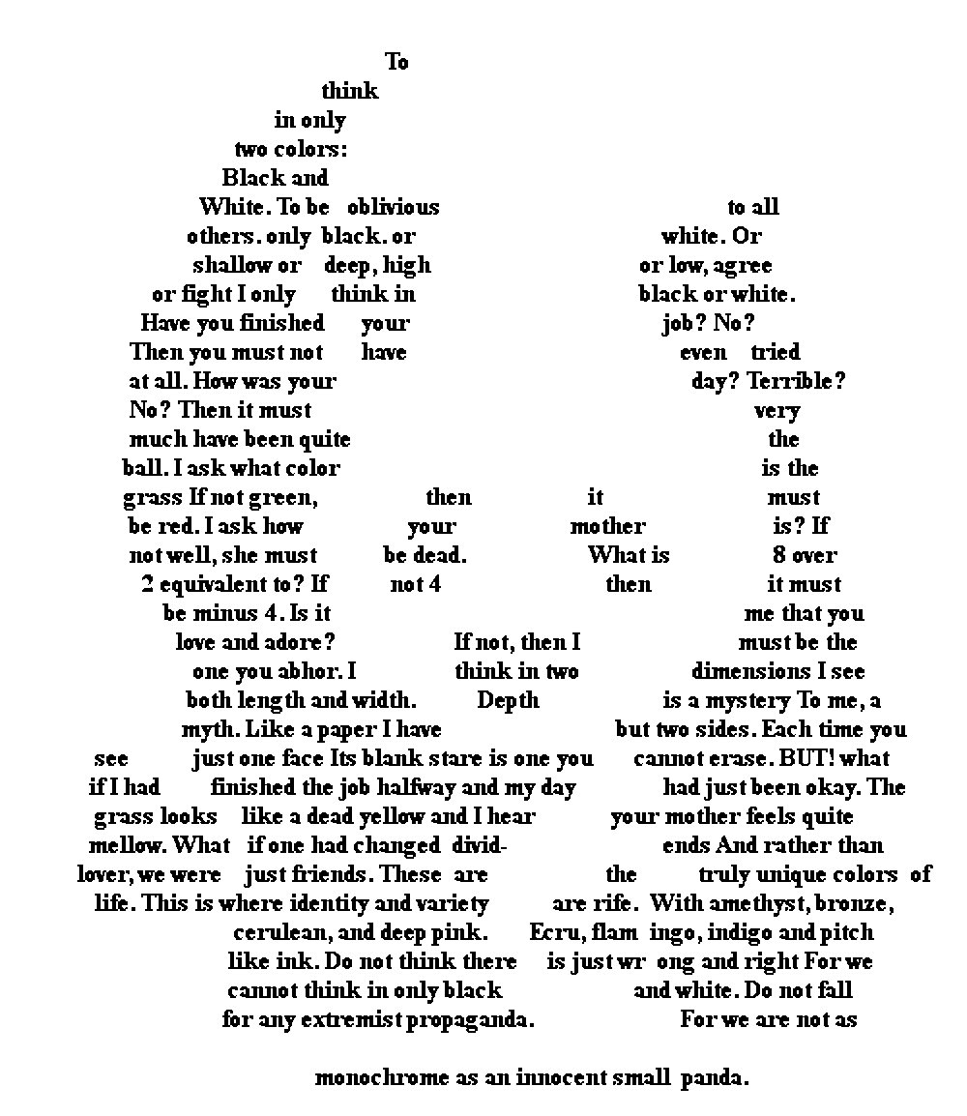
Concrete or Shape Poem

Slide 6
Acrostic Poems

Slide 7
We will also be exploring…
Limericks
Cinquains
Tyburns
Free Verse
Riddle Poem

Slide 8
In the end you will create a portfolio of your poetry.

